Slide 1
Final Project
Ahmad, Chris

Slide 2
Slide 2: Contributions of each team member (1 slide)
Both team members each contributed to the project in each developing independent optimization solutions and combining both approaches together in a compare and contrast discussion of the pros and cons based on accuracy metrics. Therefore, both team members independently engaged with all steps of optimization problem formulation:
Collective brainstorming and discussion of data to use
Data extraction, transformation, and cleansing
Objective Function Formulation – one of the key differences in our approaches, which we will examine.
Ahmad: formed a linear programming objective function with 3 inequality constraints
Chris: formed the traditional mean squared error convex objective function, with L1 and L2 constrains embedded.
Optimization implementation – both members used Python and supplemental numerical and data analysis libraries
Ahmad – used python pre-built optimization libraries and explored an alternate tree-based regressor to compare performance with unconstrained and constrained optimizations.
Chris – programmed key optimization functions by hand with custom functions for gradient descent, gradient function, ridge penalty, and lasso penalty objective functions. This approach serves to provide a custom version of the optimization that can be tweaked and iterated in future.
Parameter tuning – Ahmad done, Chris can look into hyperparameter tuning his solution
Alpha (learning rate)
Lambda (regularization parameter)
In-sample vs. Out-of-sample prediction – both members used time-split cross validation to evaluate in-sample and out-of-sample performance (e.g., MSE)
Discussions of results – each member discussed their approach, and reviewed each other’s discussions for reasonableness and accuracy.

Slide 3
3. Problem Description
Goal: (high-level, plain English description of the problem; why it is important?) (1 slide)
The goal of the project is to build a glucose prediction model that uses the fewest meaningful predictors to accurately predict glucose levels keeping prediction error low. In other words, we can examine the tradeoff between accuracy of prediction vs. sparsity (fewest predictors). A good model should have a sufficient balance that does not overfit the training data to the extent that test error is significantly worse (e.g., worse than random guess 50%).
The value of our project is to provide alternative toolkits to medical professionals working with patients with diabetes to continuously monitor and understand expected ranges of blood sugar levels pre, and post meals and throughout the day. Accurate recording of blood glucose levels at predictable intervals throughout the day can help a patient and their health care provider achieve the best possible outcomes to managing patient health and ensuring risk of adverse events (e.g., hyperglycemia) are minimized. In addition, there is a predictive benefit to understanding the correlation of patient blood glucose levels with activity indicators in helping providers understand diabetes risk factors and estimated glucose levels for new patients.
In summary, our project seeks to add a perspective to the health community in providing a way to pinpoint as accurately as possible the key potential drivers behind a particular patients glucose levels based on their recorded daily activity and inform patients distinguish helpful from unhelpful activities to managing blood glucose levels.

Slide 4
4. Optimization Model
Goal: objective function, constraints; explain the rationale behind your model) (1 slide)
As mentioned earlier, each team member formulated independently their own understanding of the objective function, each method converged within different bounds, offering the team an opportunity to evaluate the pros and cons of each method.
Ahmad: We predict a patients pre-meal glucose level using prior insulin, meal, exercise, and previous glucose levels, while selecting a spare set of predictors
Write out his objective function in mathematical form
# Variables And Definitions:
y_i: glucose value for observation i
x_i: feature vector for observation i
beta: model coefficients
z_j: binary variable indicating whether feature j is selected
c_j: cost or weight for selecting feature j
n: number of training observations
p: number of candidate features
tau: maximum acceptable prediction error
M: sufficiently large constant linking beta_j and z_j
You can say:
y_i comes only from pre-meal glucose rows
x_i may include previous glucose, insulin doses, meal indicators, exercise indicators, Day, MinuteOfDay, and lag features
Chris: Defined a conventional least squares objective function, with additional L1 and L2 regularization penalty functions to increase sparsity and size of coefficients (prioritize features with greatest driver for minimizing prediction error), respectively. Prediction error is defined as the predicted glucose level from the actual average glucose level of a patient, taken at a specific day based on a specific activity. Can iterate and enhance this
Reason: This was because we will ultimately run a regularized Linear Regression algorithm, which is sensitive to outliers. Regularized least squares is robust to outliers in the underlying data, and can help identify the most impactful features in the model with the highest coefficients.
Therefore, while there are no explicit constraints in the formulation of the objective function, the constraints are of the form <write the L1 and L2 constraints in matrix form>

Slide 5
5. Proposed Solution
Goal: is it convex/non-convex?; what is the feasible set?; why did you conclude that a solution may exist; closed-form solution; numerical solution using a toolbox, etc.) (Max 5 slide)
Ahmad: list
Chris: Least squares is convex and the feasible set is based on the data, which in our case an activity indicator is a real number greater than or equal to 0. Since our objective function is MSE, our cost is bounded below by 0 and unbounded above (i.e., infinity cost). Since least squares is quadratic, we have a clear minimum, therefore, with a sufficient initial guess and step size, our algorithm is guaranteed to converge. We do not have a closed form solution to predicting glucose level, therefore, our solution will be a numerical solution using regularized least squares regression. We aim to achieve a best fit surface but not perfect accuracy to minimize total error while maintaining sparsity (parsimonious) and out-of-sample prediction power. (i.e., achieve close enough estimation on future unseen patient activity data).

Slide 6
Validating Solution:
Prompt: How did you test your solution is valid, e.g., what dataset was used, simulation details, theoretical analysis, what problems you faced, how did you overcome them? etc. (max 5 slides)
We acquired the dataset from the UC Irvine Machine Learning Repository at the link here, https://archive.ics.uci.edu/dataset/34/diabetes. This was an open-source dataset provided for initial use for academic researchers and medical professionals, and made public to students or practitioners of machine learning for academic or personal project use.
The data set was compiled in 1994 for the AI in Medicine Symposium (i.e., AAAI Spring Symposium on Interpreting Clinical Data). We credit Isaac Kohane, AIM-94 Co-Chair 8/27/1993 who provided a high-level business synopsis of the data set for non-medical professionals. The author of the data set is Michael Kahn, MD, PhD, Washington University, St. Louis, MO). The data contains details on basic physiology and patho-physiology of diabetes mellitus and its treatment. The dataset is composed of 70 diabetes patient records collected from electronic and paper records. Patients are indexed by 1-70. Each patient has several weeks' to months' worth of outpatient care data.
The data is organized in tabular format, by patient and recording type. Patients typically have multiple recordings (i.e., code and their values) per day. Electronic recordings are timestamped at regular intervals with more adhoc recordings reflecting manual recordings (breakfast, lunch, dinner, bedtime). The raw data consists of patient data, one patient per CSV file, which are all zipped into a compressed format. Each patient (CSV file) has four features, each feature is tab-delimited. The feature names are:
Data-Codes (‘Code’): a listing of the codes used in the data sets.
Date in MM-DD-YYYY format: i.e., date of recording
Time in XX:YY format: i.e., time of recording
Value: i.e., blood glucose level
Codes will be the main set of features we will use in our optimization problem approaches, as our goal is to predict glucose levels with respect to the key codes.
Several key features are defined below:
33 = Regular insulin dose - short-acting insulin (works soon after injection, often around meals)
34 = NPH insulin dose - intermediate-acting insulin (lasts longer than regular, and is used for background insulin plan)
35 = UltraLente insulin dose - Long-acting insulin (Different role than regular insulin, as its not for immediate spikes)
48, 57 = Unspecified blood glucose measurement - Glucose was measured, but not tied to meal context

Slide 7
Validating Solution:
In order to begin our project, we extracted the data from the compressed zip file using python’s various data compression and data analysis libraries, and produced CSV format files for each patient. Then, we aggregated the patients data into one file.
Data Transformations: Because our data set is in “narrow” format and not in the traditional machine-learning ready format (“wide”) where we have one observation per row = 1 patient per 1 day and codes (events) not as individual columns, we need to conduct several processing transformations before we can split our data. To resolve this issue, we unstacked the ‘Code’ column (where we have multiple rows per patient and day with multiple rows (codes)) into ‘wide’ format where we have Codes as columns and distinct patient-timestamp rows. CO includes a PATIENT_ID (1,…,70) column as an identifier. Data will be indexed by date and patient.
Target definition: The key step prior to running our optimization problems is to define our target variable. At the start of our project, we discussed the goal being to identify the most relevant predictors (ideally, as few as possible to achieve sufficient accuracy to predict glucose levels). However, we each explored separate alternative solutions to attempt to achieve our goal.
Therefore, we refine our target objective per our distinct approaches:
Ahmad: the average of the pre-glucose measurement values
Chris: the average of the pre-glucose and post-glucose measurement values (we acknowledge this may induce artificial smoothing, however, may also yield a better out-of-sample prediction as we know we are not seeking to achieve 100% accuracy but ‘good enough’ result. These codes are ['58', '59', '60', '61', '62', '63’]. Then, Chris lags the average variable to create a forward-looking target which will induce a predictive tilt to the problem (rather than simply assessing static correlations). Lastly, drop any NA lagged values (i.e., first row). I’m also not taking into account potential for gap days.

Slide 8
Validating Solution:
Other data processing we do are:
Create a ‘timestamp’ column by concatenating date and time: this is important to maintain temporal structure.
We identified erroneous dates (i.e., “06-31-1991”)
CO encoded as 6/30/1991, the last valid last day of June
Chris’s Processing: Missing code values are filled with the mean of the code value: null values mean that for a patient, there was no measurement for a specific code at the given time. (i.e., patient was scheduled to record but did not)
It is important we do not fill with ‘0’, as this would not be reasonable to assume that a patient's blood glucose level is non-existent (i.e., should be >0). Nulls mean that no measurement for a particular code was computed on the day. However, we note that if we use the mean, this can have a limitation in which we skew our observations. Enhancement: would computing the mean by patient-day be more accurate? Right now, I could also have quite a bit of smoothing. Averaging results in artificial smoothing of the events pre/during/post meals, which we’d want to capture
Data type consistency: we convert all code values to strings (i.e., categorical variables) as that will be our predictors, both in Chris’s MSE problem and Ahmad’s binary linear programming problem.

Slide 9
Validating Solution:
Additional data processing is done by Ahmad for his solution: add in
Per Ahmad’s processing: He has X number of unique observations.
Per Chris’s processing: We have 14,741 unique observations (i.e., patient-time stamp rows) spanning 3 months of data.
Enhancement: try stratified sampling across patient, and a time-based ordered split to preserve temporal order in the data.
Next, we understand our data set through pivots, aggregation counts, and other exploratory measures.
Timeframe: add in
# patients: add in
Total recordings per patient: add in
check distribution of features for any outliers, as least squares would be sensitive to outliers
Train-Test split: Next, we divide our data into training and testing sets
Ahmad: fill in
Chris: used an 80%, 20% split, which is typical as seen in industry.
We will train our unconstrained and regularized least squares regression models on the training set, obtain our coefficients (weights), and use the weights to compute the glucose prediction for the test sample.
We will examine in addition to MSE, RMSE and MAPE (compute) to examine how accurate our solution is.

Slide 10
Validating Solution:
Prompt: How did you test your solution is valid, e.g., what dataset was used, simulation details, theoretical analysis, what problems you faced, how did you overcome them? etc. (max 5 slides)
Ahmad’s Solution: add in

Slide 11
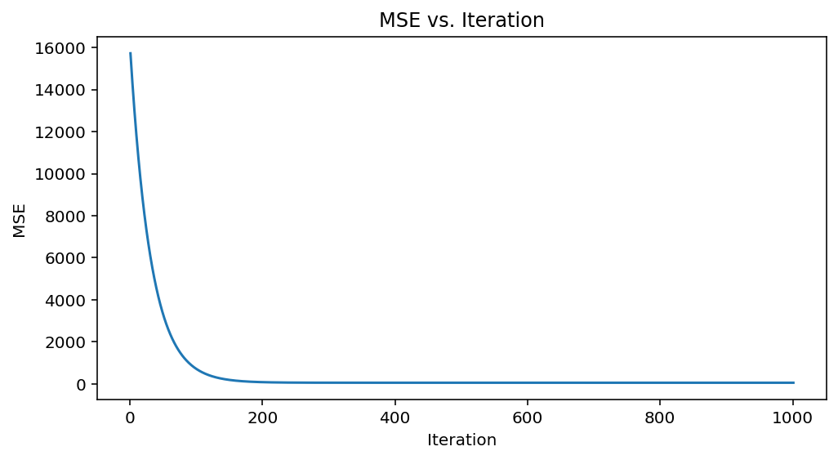
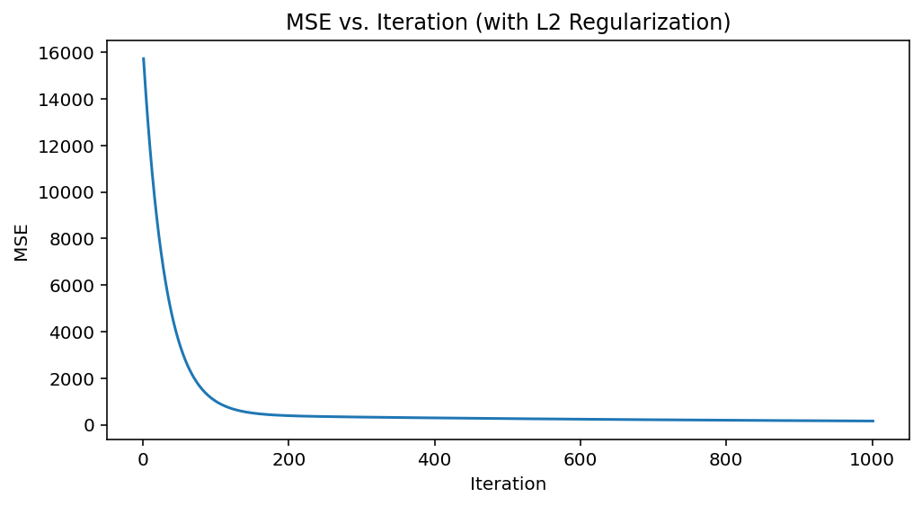
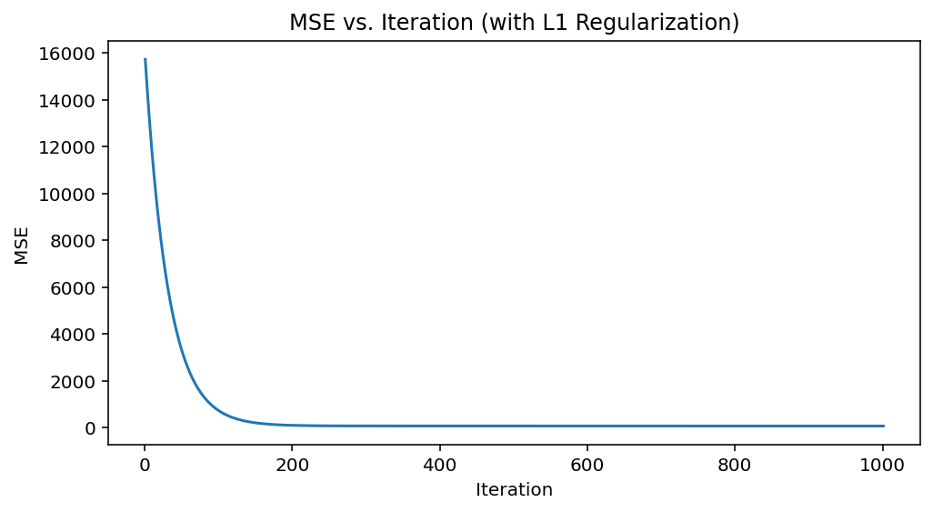
Validating Solution:
Prompt: How did you test your solution is valid, e.g., what dataset was used, simulation details, theoretical analysis, what problems you faced, how did you overcome them? etc. (max 5 slides)
Chris’s Solution: Below, we show the cost curves for our base unconstrained model, our L1-regularized model, and our L2 regularized model, all which achieve convergence. As confirmed by the MSE scores at the final iteration (1000), our MSE is as follows. We can see that as expected, our Base model is the least parsimonious and may have reduced prediction potential on future patient data. L1 regularization trims the features to the first several and zeros out the remainder, while ridge regression includes all features but shrinks the influence of those coefficients who don’t add explanatory power towards predicting glucose (i.e., have high variance to the target).The bias term can interpreted as the ‘steady-state’ glucose level of the patient (i.e., assuming fasting and no meals or other activity).
Enhancements: 1. Plot RMSE (i.e., y magnitude smaller and also will be in units of measurement); 2. combine plots as one figure; 3. write out the final equations / code in python as dot products between X and weights for predictions. Why do we not have negative coefficients like with Ahmad (look at further).
Term | Base Model | L1 | L2
bias | 113.9795 | 114.9873 | 141.384
4 | 1 | 0 | 0.367695
33 | 3.131257 | 2.152107 | 1.553801
34 | 5.261244 | 4.300446 | 2.715894
35 | 52.45049 | 51.94647 | 28.90062
36 | 1 | 0 | 0.367695
48 | 35.81621 | 35.14233 | 19.64138
56 | 29.75248 | 29.01033 | 16.17312
57 | 33.38664 | 32.69128 | 18.24014
64 | 36.97191 | 36.30209 | 20.19479
65 | 1 | 0 | 0.367695
66 | 1 | 0 | 0.367695
67 | 1 | 0 | 0.367695
68 | 1 | 0 | 0.367695
69 | 1 | 0 | 0.367695
70 | 1 | 0 | 0.367695
71 | 1 | 0 | 0.367695
72 | 1 | 0 | 0.367695

Slide 12
7. Key Insights
Goal: What does your solution mean for the problem? What are the key observations you made from the solutions as applied to the problem? (max 3 slides)
Our solution identifies the most relevant features (codes) to determining the blood glucose level.
We need to compute the accuracy of our model:
We split the data into training and testing
We just need to run the testing predctions
Ahmad – look at using PCA to identifying them most relevant codes to blood glucose level.

Slide 13
8. Major Conclusions
Goal: was your approach viable? Did you run into any difficulties such as infeasibility, numerical instability, unexpected results, etc. (2 slide)
xxx

Slide 14
9. Suggestions for Improvement and Future Work - Ahmad
Goal: if you had more time and resources what would you have done to solve the problem? e.g., considered a more realistic model, used a larger dataset, implemented a working prototype, launched a startup and become a billionaire! (1 slide)
xxx

Slide 15
Overview of the data (per the domain description file):
Patients with IDDM are insulin deficient. This can either be due to a) low or absent production of insulin by the beta islet cells of the pancreas subsequent to an auto-immune attack or b) insulin-resistance, typically associated with older age and obesity, which leads to a relative insulin-deficiency even though the insulin levels might be normal. Regardless of cause, the lack of adequate insulin effect has multiple metabolic effects. However, once a patient is diagnosed and is receiving regularly scheduled exogenous (externally administered) insulin, the principal metabolic effect of concern is the potential for hyperglycemia (high blood glucose). Chronic hyperglycemia over a period of several years puts a patient at risk for several kinds of micro and macrovascular problems (e.g. retinopathy). Consequently, the goal of therapy for IDDM is to bring the average blood glucose as close to the normal range as possible. As explained below, current therapy makes this goal a very challenging (and often frustrating) one for most patients. One important consideration is that due to the inevitable variation of blood glucose (BG) around the mean, a lower mean will result in a higher frequency of unpleasant and sometimes dangerous low BG levels.
Outpatient management. Outpatient management of IDDM relies principally on three interventions: diet, excercise and exogenous insulin. Proper treatment requires careful consideration of all three interventions. This is basically our target variable, measured by seeking to bring glucose levels to within normal range (e.g., mean).
INSULIN One of insulin's principal effects is to increase the uptake of glucose in many of the tissues (e.g. in adipose/fat tissue) and thereby reduce the concentration glucose in blood. Patients with IDDM administer insulin to themselves by subcutaneous injection. Insulin doses are given one or more times a day, typically before meals and sometimes also at bedtime. Many insulin regimens are devised to have the peak insulin action coincide with the peak rise in BG during meals. In order to achieve this, a combination of several preparations of insulin may be administered. Each insulin formulation has its own characteristic time of onset of effect (O), time of peak action (P) and effective duration (D). These times can be significantly affected by many factors such as the site of injection (e.g. much more rapid absorption in the abdomen than in the thigh) or whether the insulin is a human insulin or an animal extract. The times I have listed below are rough approximations and I am sure that I could find an endocrinologist with different estimates.
Regular Insulin: O 15-45 minutes P 1-3 hours D 4-6 hours
NPH Insulin: O 1-3 hours P 4-6 hours D: 10-14 hours
Ultralente: O: 2-5 hours. P (not much of a peak) D 24-30 hours.
EXERCISE Exercise appears to have multiple effects on BG control. Two important effects are: increased caloric expenditure and a possibly independent increase in the sensitivity of tissues to insulin action. BG can fall during exercise but also quite a few hours afterwards. For instance, strenuous exercise in the mid-afternoon can be associated with low BG after dinner. Also, too strenuous exercise with associated mild dehydration can lead to a transient increase in BG.
DIET. Another vast subject but (suffice it to say for the purposes of users of the data set) in brief: a larger meal will lead to a longer and possibly higher elevation of blood glucose. The actual effect depends on a host of variables, notably the kind of food ingested. For instance, fat causes delayed emptying of the stomach and therefore a slower rise in BG than a starchy meal without fat. Missing a meal or eating a meal of smaller than usual size will put the patient at risk for low BG in the hours that follow the meal.
GLUCOSE CONCENTRATIONS. BG concentration will vary even in individuals with normal pancreatic hormonal function. A normal pre-meal BG ranges approximately 80-120 mg/dl. A normal post-meal BG ranges 80-140 mg/dl. The target range for an individual with diabetes mellitus is very controversial. I will cut the Gordian knot on this issue by noting that it would be very desirable to keep 90% of all BG measurements < 200 mg/dl and that the average BG should be 150 mg/dl or less. Note that it takes a lot of work, attention and (painful) BG checks to reach this target range. Conversely, an average BG > 200 (over several years) is associated with a poor long-term outcome. That is, the risk of vascular complications of the high BG is signicantly elevated.
Hypoglycemic (low BG) symptoms fall into two classes. Between 40-80 mg/dl, the patient feels the effect off the adrenal hormone epinephrine as the BG regulation systems attempt to reverse the low BG. These so-called adrenergic symptoms (headache, abdominal pain, sweating) are useful, if unpleasant, cues to the patient that their BG is falling dangerously. Below 40 mg/dl, the patient's brain is inadequately supplied with glucose and the symptoms become those of poor brain function (neuroglycopenic symptoms). These include: lethargy, weakness, disorientation, seizures and passing out.

Slide 16
References and Supporting Material
Helpful python libraries:
Data compression: https://pypi.org/project/ncompress/
Tarfile library: https://docs.python.org/3/library/tarfile.html
Definitions of Codes:
Glucose level codes:
48 = Unspecified blood glucose measurement
57 = Unspecified blood glucose measurement
58 = Pre-breakfast blood glucose measurement
59 = Post-breakfast blood glucose measurement
60 = Pre-lunch blood glucose measurement
61 = Post-lunch blood glucose measurement
62 = Pre-supper blood glucose measurement
63 = Post-supper blood glucose measurement
64 = Pre-snack blood glucose measurement

